Slide 1
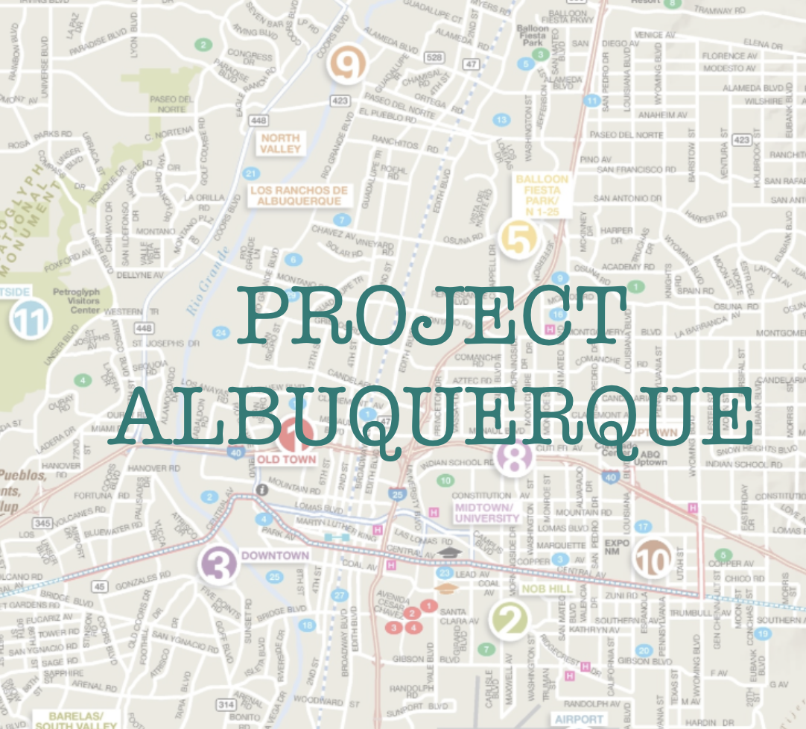
Project Albuquerque
Play your favorite Star Wars game in text online!
Sam Berger
Kevin Kirk
Krishna Adettiwar
Max Hayne
Hunter Haller

Slide 2



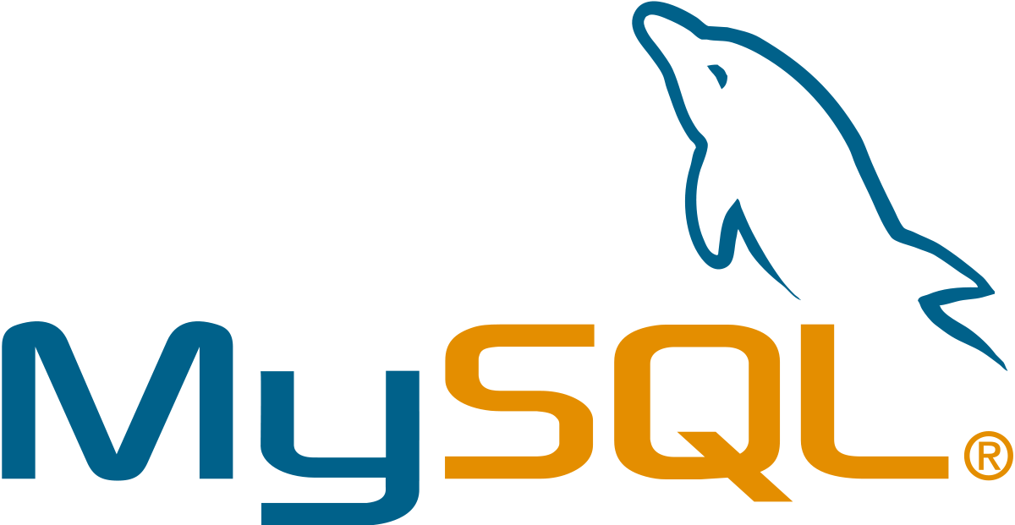


Tools and Methods
GitHub for version control (5/5)
Messenger for communication (5/5)
Trello for project tracking (2/5)
MySQL for databases (5/5)
AWS server for deployment (3/5)
Wetty and ngrok (5/5)
Agile method

Slide 3
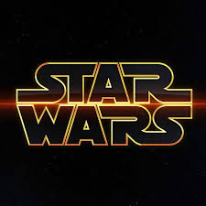
What did we do?
Star Wars: The Empire Strikes Back
Text based game with MySQL
Mobile Terminal
C++

Slide 4

How did we implement it?
Constant communication
Clear objectives and goals
Team meetings (scrums)

Slide 5
Process and Challenges
Implementing a C++ terminal that ran in a web browser
Implementing an inventory system

Slide 6
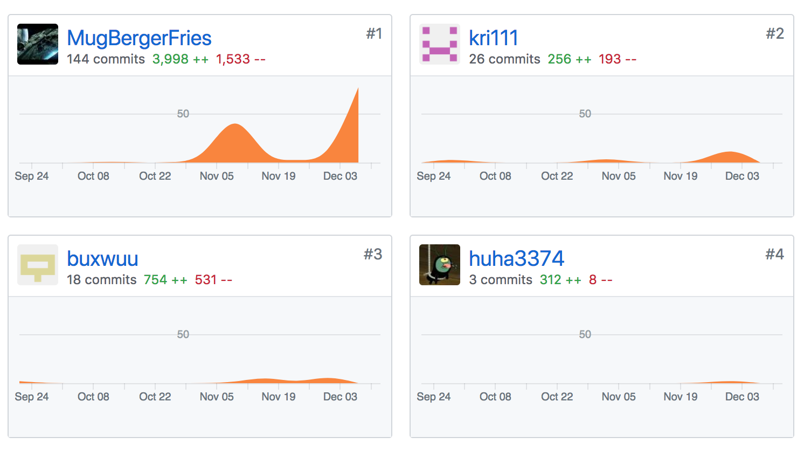

Slide 7
Now, a live demo!

